Slide 1
Walk and Roll to School Day

Slide 2
2014: A Record Breaking Year!
 | # of Schools | # of Students
2010 | 30 | 7,000
2011 | 44 | 7,200
2012 | 55 | 8,500
2013 | 76 | 12,800
2014 | 84 | ~14,000

Slide 3
Central Media Event
Bessie Carmichael Elementary School
Speakers:
Principal, Tina Lagdamen
Mayor, Ed Lee
District 6 Supervisor, Jane Kim
Superintendent, Richard Carranza
SFPD Police Chief, Greg Suhr
Parents!
Walk SF Executive Director, Nicole Schneider

Slide 4
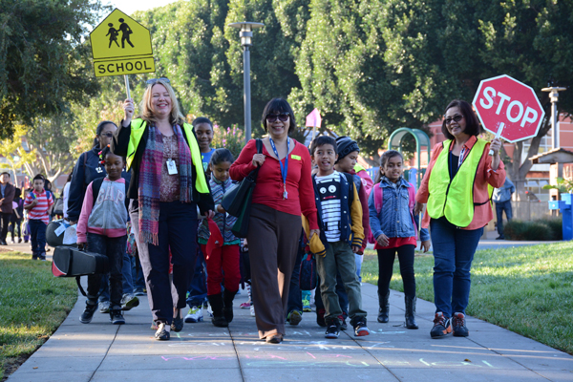
Safety Improvements Announced!

Slide 5
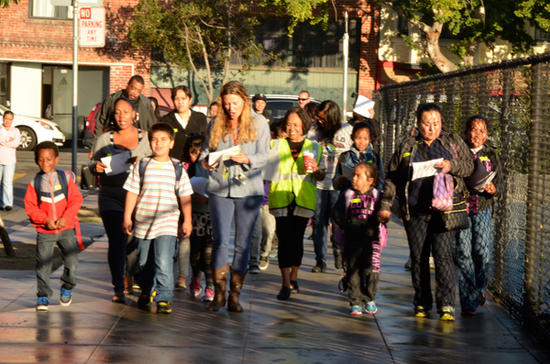

Slide 6
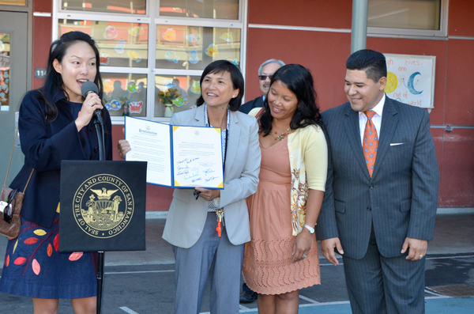
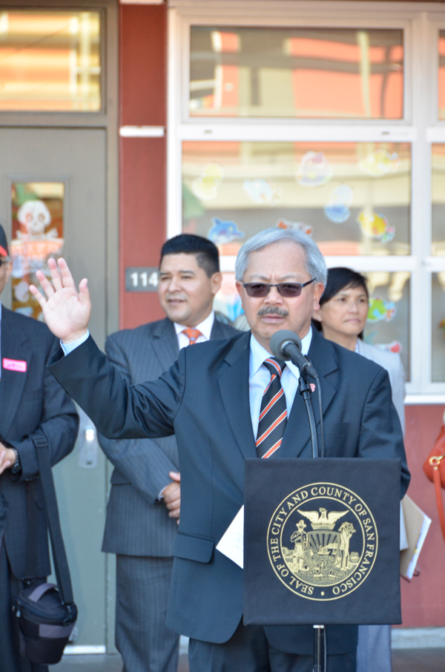
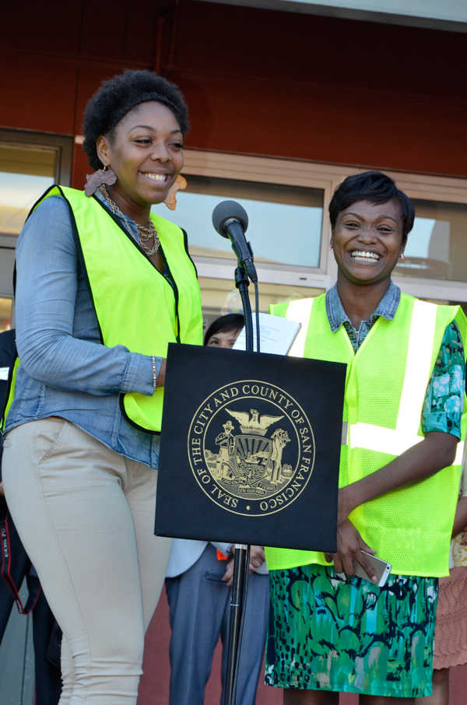

Slide 7
Thanks to our Sponsors!

Slide 8
Thanks to our Partners!

